Slide 1
IN723 BGP Introduction
Background
Overview
AS
Internet peering
BGP vs IGP
iBGP vs eBGP
Basic config

Slide 2
Resources
Case Studies
http://www.cisco.com/c/en/us/support/docs/ip/border-gateway-protocol-bgp/26634-bgp-toc.html
Configuration Guide
http://www.cisco.com/c/en/us/td/docs/ios-xml/ios/iproute_bgp/configuration/15-mt/irg-15-mt-book.html
Command Reference
http://www.cisco.com/c/en/us/td/docs/ios-xml/ios/iproute_bgp/command/irg-cr-book.html
Notes:
Microsegmentation = split a larger collision domain into smaller ones in order to reduce collision probability

Slide 3
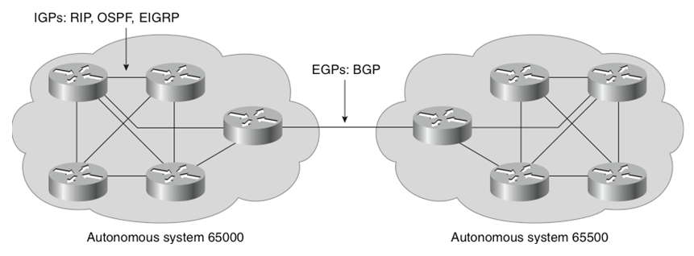
IGP versus EGP
Interior gateway protocol (IGP)
A routing protocol operating within an Autonomous System (AS).
RIP, OSPF, and EIGRP are IGPs.
Exterior gateway protocol (EGP)
A routing protocol operating between different AS.
BGP is an interdomain routing protocol (IDRP) and is an EGP.

Slide 4
Autonomous Systems (AS)
An AS is a group of routers that share similar routing policies and operate within a single administrative domain.
An AS typically belongs to one organization.
A single or multiple interior gateway protocols (IGP) may be used within the AS.
In either case, the outside world views the entire AS as a single entity.
If an AS connects to the public Internet using an exterior gateway protocol such as BGP, then it must be assigned a unique AS number which is managed by the Internet Assigned Numbers Authority (IANA).

Slide 5
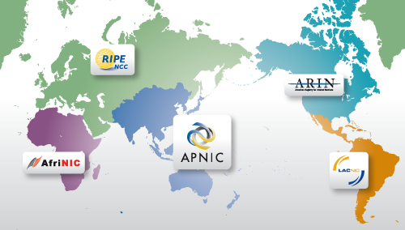
IANA
The IANA is responsible for allocating AS numbers through five Regional Internet Registries (RIRs).
RIRs are nonprofit corporations established for the purpose of administration and registration of IP address space and AS numbers in key geographic locations.

Slide 6
AS Numbers
AS numbers can be between 1 to 65,535.
RIRs manage the AS numbers between 1 and 64,512.
The 64,512 - 65,535 numbers are reserved for private use (similar to IP Private addresses).
The IANA is enforcing a policy whereby organizations that connect to a single provider use an AS number from the private pool.
Note:
The current AS pool of addresses is running out.
For this reason, the IETF has released RFC 4893 and RFC 5398.
These RFCs describe BGP extensions to increase the AS number from the two-octet (16-bit) field to a four-octet (32-bits) field, increasing the pool size from 65,536 to 4,294,967,296 values.
Notes:
You need to use the IANA-assigned autonomous system number, rather than a private autonomous system number, only if your organization plans to use an EGP, such as BGP, to connect to a public network such as the Internet.

Slide 7
BGP Basics
The Internet is a collection of autonomous systems that are interconnected to allow communication among them.
BGP provides the routing between these autonomous systems.
BGP is a path vector protocol.
It is the only routing protocol to use TCP.
OSPF and EIGRP operate directly over IP. IS-IS is at the network layer.
RIP uses the User Datagram Protocol (UDP) for its transport layer.

Slide 8
BGP Basics
BGP version 4 (BGP-4) is the latest version of BGP.
Defined in RFC 4271.
Supports supernetting, CIDR and VLSM .
BGP4 and CIDR prevent the Internet routing table from becoming too large.
Without CIDR, the Internet would have 2,000,000 + entries.
With CIDR, Internet core routers manage around 300,000 entries.
http://bgp.potaroo.net/

Slide 9
Where did it come from / why
Created to replace the Exterior Gateway Protocol (EGP)
Originally the ARPANET backbone ran a distance vector protocol called Gateway to Gateway Protocol (GGP) – hop based (precursor to modern IGPs)
GGP had scalability issues – all gateways know all routes
Solution – migrate from single internetwork to multiple interconnected autonomous systems (AS)
EGP was designed to allow exterior gateways to share routing information (inter AS)

Slide 10
EGP
EGP had issues:
Unable to detect routing loops and susceptible to propagating inaccurate network information
Described as “Mind numbingly slow” e.g 1 hour to detect a failure 4 hops away
Little support for policies
Scalability issues
BGP was introduced to correct these issues and support the decentralised internet of today
BGP version 4 introduced CIDR & aggregation support

Slide 11
BGP vs other protocols
Path vector protocol
AS path list is recorded - used for loop avoidance
- its length for path selection (shortest preferred)
- policy enforcement
TCP (179)
No multicast / broadcast issues
No undesirable route leakage
Easy to know who you should be peering with (explicit config)
Multihop peering
next-hop advertised
Allows forwarding path to be separate from path route received by
Policy control
Use BGP attributes to create more complex policies

Slide 12
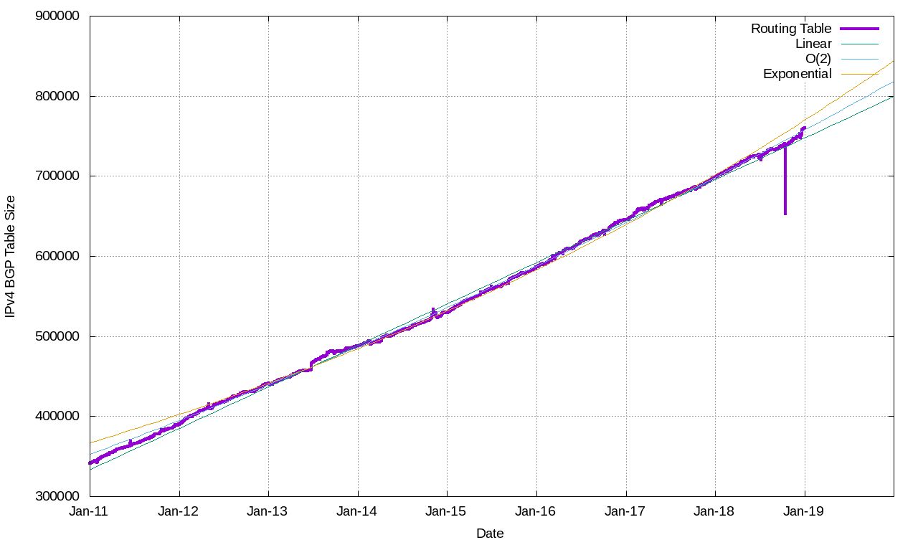
BGP IPv4 Internet Routes
Notes:
https://blog.apnic.net/wp-content/uploads/2019/01/bgpv4fig25.png
Jan 2019 = 755,000
768K limit problem for many routers

Slide 13
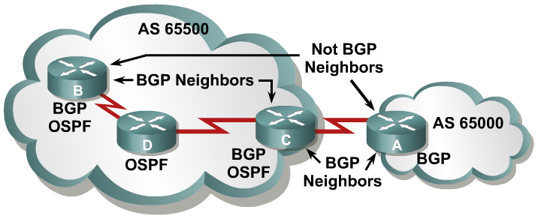
BGP Operational Overview
When two routers establish a TCP enabled BGP connection, they are called neighbors or peers.
Peer routers exchange multiple connection messages.
Each router running BGP is called a BGP speaker.
Notes:
No one router can handle communications with all the routers that run BGP. There are tens of thousands of routers that run BGP and are connected to the Internet, representing more than 21,000 autonomous systems.
A BGP router forms a direct neighbor relationship with a limited number of other BGP routers. Through these BGP neighbors, a BGP router learns of the paths through the Internet to reach any advertised network. Any router that runs BGP is known as a BGP speaker.
The term “BGP peer” has a specific meaning: a BGP speaker that is configured to form a neighbor relationship with another BGP speaker for the purpose of directly exchanging BGP routing information with each other. A BGP speaker has a limited number of BGP neighbors with which it peers and forms a TCP-based relationship.
BGP peers are also known as BGP neighbors and can be either internal or external to the autonomous system.
A BGP peer must be configured with a BGP neighbor command. The administrator instructs the BGP speaker to establish a relationship with the address listed in the neighbor command and to exchange the BGP routing updates with that neighbor.

Slide 14
BGP Operational Overview
When BGP neighbors first establish a connection, they exchange all candidate BGP routes.
After this initial exchange, incremental updates are sent as network information changes.
Notes:
Incremental updates are more efficient than complete table updates.
This is especially true with BGP routers, which may contain the complete Internet routing table.

Slide 15
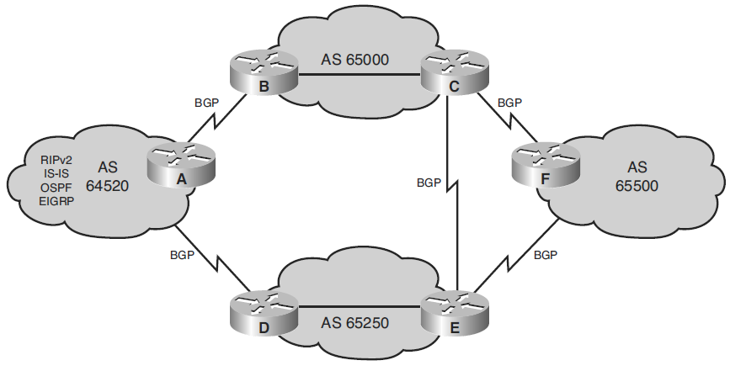
BGP Use Between AS
BGP provides an interdomain routing system that guarantees the loop-free exchange of routing information between autonomous systems.
Notes:
BGP tracks which AS learned prefixes have passed through. BGP will not accept a prefix that has the local AS in its path.

Slide 16
Comparison BGP with IGPs
BGP works differently than IGPs because it does not make routing decisions based on best path metrics.
Instead, BGP is a policy-based routing protocol that allows an AS to control traffic flow using multiple BGP attributes.
Routers running BGP exchange network attributes including a list of the full path of BGP AS numbers that a router should take to reach a destination network.
BGP allows an organization to fully use all of its bandwidth by manipulating these path attributes.

Slide 17
Comparing IGPs with BGP
Protocol | Interior or Exterior | Type | Hierarchy Required? | Metric
RIP | Interior | Distance vector | No | Hop count
OSPF | Interior | Link state | Yes | Cost
IS-IS | Interior | Link state | Yes | Metric
EIGRP | Interior | Advanced distance vector | No | Composite
BGP | Exterior | Path vector | No | Path vectors (attributes)

Slide 18
Connecting Enterprise Networks to an ISP
Modern corporate IP networks connect to the global Internet.
Requirements that must be determined for connecting an enterprise to an ISP include the following:
Public IP address space
Enterprise-to-ISP connection link type and bandwidth
Connection redundancy
Routing protocol
Notes:
Public IP address space—In the rare case that only one-way connectivity, from the clients to the Internet, is required, private IP addresses with Network Address Translation (NAT) are used, allowing clients on a private network to communicate with servers on the public Internet.
Typically, though, two-way connectivity is needed, such that clients external to the enterprise network can access resources in the enterprise network.
In this case, both public and private address space is needed, as is routing.
Enterprise-to-ISP connection link type and bandwidth—The type and bandwidth available depends on the ISP and may include leased line, Ethernet over fiber or copper, and various types of digital subscriber line (DSL) (also known as xDSL).
The bandwidth provisioned should address the enterprise Internet connectivity requirements.
Routing protocol—Either static or dynamic routing.
Connection redundancy—The type of redundancy required for the enterprise network to ISP connectivity must be evaluated. Options include edge router redundancy, link redundancy, and ISP redundancy.

Slide 19


Connection Redundancy
Connecting to One ISP
Connecting to Two or more ISPs
Single-homed
Multihomed
Dual-homed
Dual-multihomed
Notes:
Q&A – considerations for ISP connectivity?

Slide 20
Connecting to One ISP: Dual-Homed
Routing deployment options include:
Primary and backup link functionality in case the primary link fails.
Load sharing using Cisco Express Forwarding (CEF).
Regardless, routing can be either static or dynamic (BGP).
Option 1:
Company A
ISP
Internet
R1
PE
Option 2:
Company A
ISP
Internet
R1
PE
R2
Notes:
Depending on the Service-level agreement (SLA) signed with the ISP.

Slide 21
Connecting to Multiple ISPs: Multihomed
Connections from different ISPs can terminate on the same router, or on different routers to further enhance the resiliency.
Routing must be capable of reacting to dynamic changes therefore BGP is typically used.
ISP 1
PE
Company A
R1
Internet
R2
ISP 2
PE
Notes:
Depending on the Service-level agreement (SLA) signed with the ISP.

Slide 22
Connecting to Multiple ISPs: Multihomed
Multihomed benefits include:
Achieving an ISP-independent solution.
Scalability of the solution, beyond two ISPs.
Resistance to a failure to a single ISP.
Load sharing for different destination networks between ISPs.
ISP 1
PE
Company A
R1
Internet
R2
ISP 2
PE
Notes:
Depending on the Service-level agreement (SLA) signed with the ISP.

Slide 23
Connecting Multiple ISPs: Dual-Multihomed
Dual multihomed includes all the benefits of multihomed connectivity, with enhanced resiliency.
The configuration typically has multiple edge routers, one per ISP, and uses BGP.
ISP 1
PE
Company A
R1
Internet
R2
ISP 2
PE
Notes:
Depending on the Service-level agreement (SLA) signed with the ISP.

Slide 24
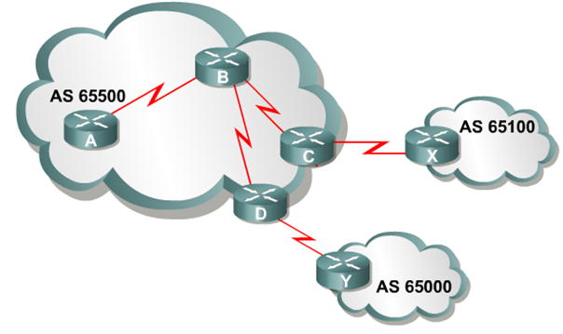
Using BGP in an Enterprise Network
When BGP is running between routers in different AS, it is called External BGP (EBGP).
When BGP is running between routers in the same AS, it is called Internal BGP (IBGP).
IBGP
IBGP
IBGP
EBGP
EBGP

Slide 25
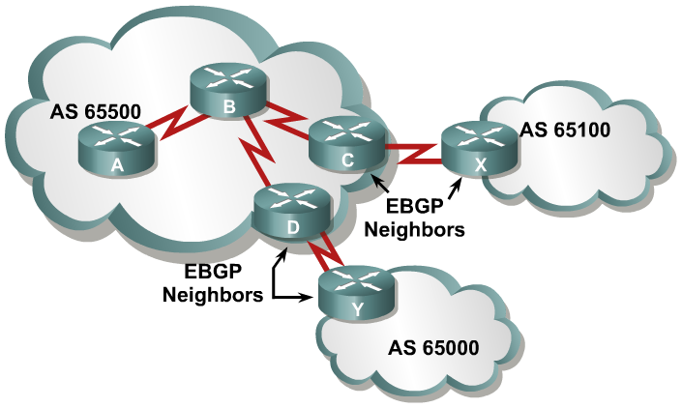
External BGP
EBGP neighbors are in different autonomous systems.
EBGP neighbors are usually directly connected.
Notes:
Recall that when BGP is running between routers in different autonomous systems, it is called EBGP. By default, routers running EBGP are directly connected to each other.
An EBGP neighbor is a router outside this autonomous system; an IGP is not run between the EBGP neighbors. For two routers to exchange BGP routing updates, the TCP-reliable transport layer on each side must successfully pass the TCP three-way handshake before the BGP session can be established. Therefore, the IP address used in the BGP neighbor command must be reachable without using an IGP, which can be accomplished by pointing at an address that is reachable through a directly connected network or by using static routes to that IP address. Generally, the neighbor address that is used is the address on a directly connected network.

Slide 26
EBGP Neighbor Relationship Requirements
Define neighbors:
A TCP session (three-way handshake) must be established before starting BGP routing update exchanges.
Reachability:
EBGP neighbors are usually directly connected.
Different AS number:
EBGP neighbors must have different AS numbers.

Slide 27
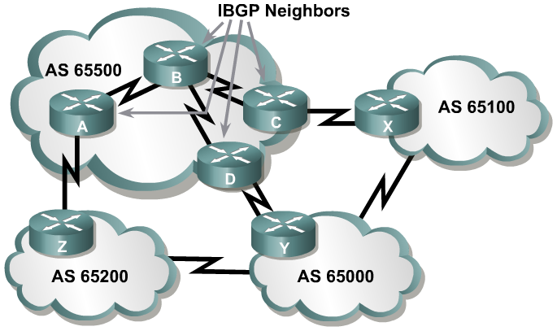
Internal BGP
IBGP neighbors are in the same autonomous systems.
IBGP neighbors do not need to be directly connected.
Notes:
Recall that BGP that runs between routers within the same autonomous system is called IBGP. IBGP runs within an autonomous system to exchange BGP information so that all BGP speakers have the same BGP routing information about outside autonomous systems.
Routers running IBGP do not have to be directly connected to each other as long as they can reach each other so that TCP handshaking can be performed to set up the BGP neighbor relationships. The IBGP neighbor can be reached by a directly connected network, static routes, or by the internal routing protocol. Because multiple paths generally exist within an autonomous system to reach the other IBGP routers, a loopback address is generally used in the BGP neighbor command to establish the IBGP sessions.
Example: Internal BGP
When multiple routers in an autonomous system are running BGP, they exchange BGP routing updates with one another. In the figure, routers A, D, and C learn the paths to the external autonomous systems from their respective EBGP neighbors (Z, Y, and X). If the link between D and Y goes down, D must learn new routes to the external autonomous systems. Other BGP routers within AS 65500 that were using D to get to external networks must also be informed that the path through D is not available. Those BGP routers within AS 65500 need to have the alternate paths through routers A and C in their BGP forwarding database. You must set up IBGP sessions between all BGP routers in AS 65500, so each router within the autonomous system learns about paths to the external networks via IBGP.

Slide 28
IBGP Neighbor Relationship Requirements
Define neighbors:
A TCP session (three-way handshake) must be established before starting BGP routing update exchanges.
Reachability:
IBGP neighbors must be reachable usually by using an IGP.
Loopback IP addresses are typically used to identify IBGP neighbors.
Same AS number:
IBGP neighbors must have the same AS number.

Slide 29
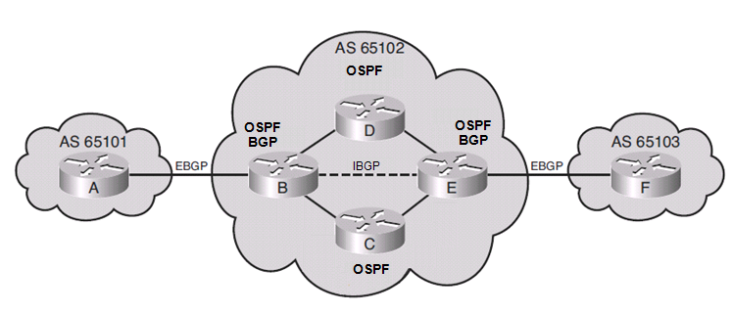
IBGP in a Transit AS
A transit AS is an AS that routes traffic from one external AS to another external AS.
In this example, AS 65102 is a service provider network.
Only the two edge routers (router B and E) are running BGP and have established an IBGP neighbor relationship using OSPF.
Although the EBGP routes could be redistributed into OSPF, the potential number of BGP routes may overwhelm OSPF and is therefore not recommended.
Notes:
Because the current Internet routing table is very large, redistributing all the BGP routes into an IGP is not a scalable way for the interior routers within an autonomous system to learn about the external networks.
Another method that you can use is to run IBGP on all routers within the autonomous system.
It is important to know that all routers in the path between IBGP neighbors within an autonomous system, known as the transit path, must also be running BGP.
These IBGP sessions must be fully meshed.

Slide 30
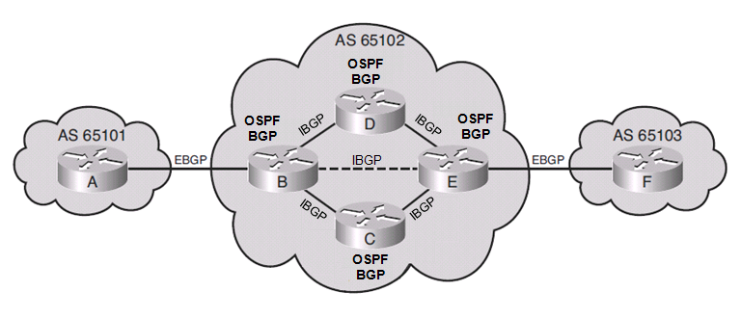
IBGP in a Transit AS
A better solution for a provider network would be to have a fully meshed BGP internetwork.
BGP runs on all internal routers and all routers establish IBGP sessions.
IBGP routers have complete knowledge of external routes.
Notes:
Because the current Internet routing table is very large, redistributing all the BGP routes into an IGP is not a scalable way for the interior routers within an autonomous system to learn about the external networks.
Another method that you can use is to run IBGP on all routers within the autonomous system.
It is important to know that all routers in the path between IBGP neighbors within an autonomous system, known as the transit path, must also be running BGP.
These IBGP sessions must be fully meshed.

Slide 31
IBGP in a Nontransit AS
A nontransit AS is an AS that does not route traffic from one external AS to another external AS.
Nontransit AS networks are typically enterprise networks.
All routers in a nontransit AS must still have complete knowledge of external routes.
To avoid routing loops within an AS, BGP specifies that routes learned through IBGP are never propagated to other IBGP peers.
It is assumed that the sending IBGP neighbor is fully meshed with all other IBGP speakers and has sent each IBGP neighbor the update.
Notes:
Full mesh considerations
Because the current Internet routing table is very large, redistributing all the BGP routes into an IGP is not a scalable way for the interior routers within an autonomous system to learn about the external networks.
Another method that you can use is to run IBGP on all routers within the autonomous system.

Slide 32
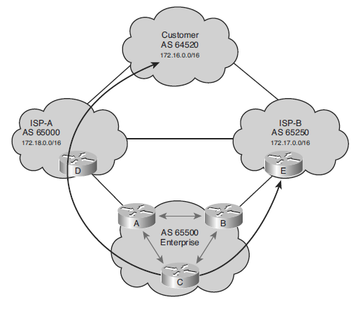
BGP in an Enterprise Example
Enterprise AS 65500 is learning routes from both ISP-A and ISP-B via EBGP and is also running IBGP on all of its routers.
If one of the connections to the ISPs goes down, traffic will be sent through the other ISP.
An undesirable situation could occur if the enterprise AS is configured as a transit AS.
For example, AS 65500 learns the 172.18.0.0/16 route from ISP-A.
If router B advertises that route to ISP-B, then ISP-B may decide to use it.
This undesirable configuration could be avoided through careful BGP configuration.
Notes:
Enterprise AS 65500 in the above figure is learning routes from both ISP-A and ISP-B via EBGP and is also running IBGP on all of its routers.
AS 65500 learns about routes and chooses the best way to each one based on the configuration of the routers in the autonomous system and the BGP routes passed from the ISPs.
If one of the connections to the ISPs goes down, traffic will be sent through the other ISP.
One of the routes that AS 65500 learns from ISP-A is the route to 172.18.0.0/16. If that route is passed through AS 65500 using IBGP and is mistakenly announced to ISP-B, then ISP-B may decide that the best way to get to 172.18.0.0/16 is through AS 65500, instead of through the Internet. AS 65500 would then be considered a transit autonomous system, which is a very undesirable situation. AS 65500 wants to have a redundant Internet connection, but does not want to act as a transit autonomous system between the two ISPs. Careful BGP configuration is required to avoid this situation.

Slide 33
Three Multihoming Connection Options
Each ISP passes only a default route to the AS.
The default route is passed on to internal routers.
Each ISP passes only a default route and provider-owned specific routes to the AS.
These routes may be propagated to internal routers, or all internal routers in the transit path can run BGP to exchange these routes.
Each ISP passes all routes to the AS.
All internal routers in the transit path run BGP to exchange these routes.

Slide 34
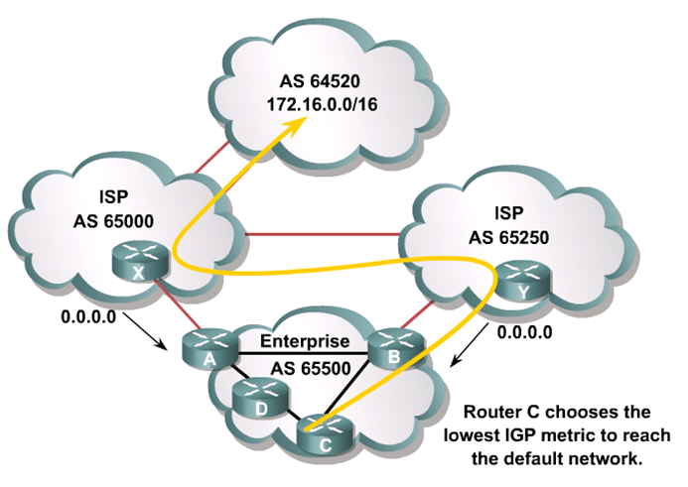
Default Routes from All Providers
Notes:
The first multihoming option is to receive only a default route from each ISP. This configuration requires the least resources within the autonomous system because a default route is used to reach any external destinations. The autonomous system sends all its routes to the ISPs, which process and pass them on to other autonomous systems.
If a router in the autonomous system learns about multiple default routes, the local interior routing protocol installs the best default route into the routing table. From the perspective of this router, it takes the default route with the least-cost IGP metric. This IGP default route will route packets destined to the external networks to an edge router of this autonomous system, which is running EBGP with the ISPs. The edge router will use the BGP default route to reach all external networks.
The route that inbound packets take to reach the autonomous system is decided outside the autonomous system (within the ISPs and other autonomous systems).
A customer that chooses to receive default routes from all providers must understand the following limitations of this option:
Path manipulation cannot be performed because only a single route is being received from each ISP.
Bandwidth manipulation is extremely difficult and can be accomplished only by manipulating the IGP metric of the default route.
Diverting some of the traffic from one exit point to another is challenging because all destinations are using the same default route for path selection.
Example: Default Routes from All Providers
In the above figure, AS 65000 and AS 65250 send default routes into AS 65500. The ISP that a specific router within AS 65500 uses to reach any external address is decided by the IGP metric that is used to reach the default route within the autonomous system.
For example, if you use RIP within AS 65500, router C selects the route with the lowest hop count to the default route when sending packets to network 172.16.0.0.

Slide 35
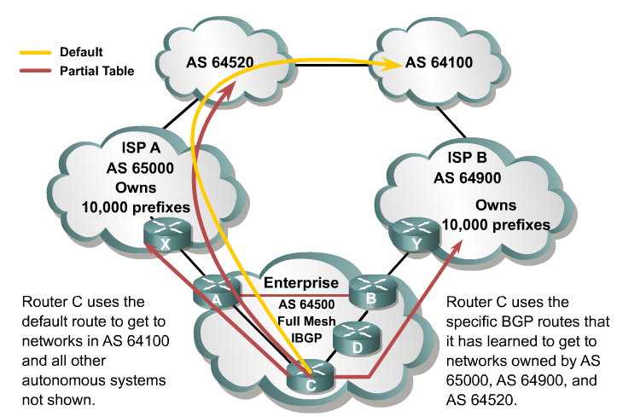
Default Routes and Partial Updates
Notes:
In the second design option for multihoming, all ISPs pass default routes plus select specific routes to the autonomous system.
An enterprise running EBGP with an ISP that wants a partial routing table generally receives the networks that the ISP and its other customers own (common in NZ). The enterprise can also receive the routes from any other autonomous system.
Major ISPs are assigned between 2000 and 10,000 CIDR blocks of IP addresses from the IANA, which they reassign to their customers. If the ISP passes this information to a customer that wants only a partial BGP routing table, the customer can redistribute these routes into its IGP. The internal routers of the customer (these routers are not running BGP) can then receive these routes via redistribution. They can take the nearest exit point based upon the best metric of specific networks instead of taking the nearest exit point based on the default route.
Acquiring a partial BGP table from each provider is beneficial because path selection will be more predictable than when using a default route.
Example: Default Routes from All Providers and Partial Table
In this figure, ISPs in AS 65000 and AS 64900 send default routes and the routes that each ISP owns to AS 64500. The enterprise (AS 64500) asked both providers to also send routes to networks in AS 64520 due to the amount of traffic between AS 64520 and AS 64500.
By running IBGP between the internal routers within AS 64500, AS 64500 can choose the optimal path to reach the customer networks (AS 64520 in this case). The routes to AS 64100 and to other autonomous systems not shown in the figure that are not specifically advertised to AS 64500 by ISP A and ISP B are decided by the IGP metric that is used to reach the default route within the autonomous system.

Slide 36
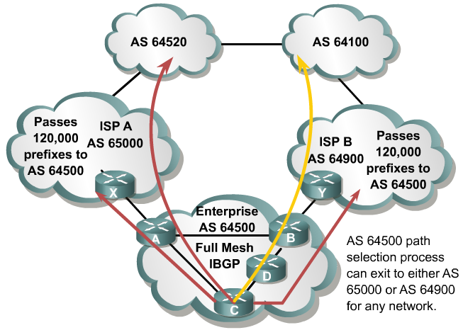
Full Routes from All Providers
Notes:
In the third multihoming option, all ISPs pass all routes to the autonomous system, and IBGP is run on at least all the routers in the transit path in this autonomous system.
This option allows the internal routers of the autonomous system to take the path through the best ISP for each route.
This configuration requires a lot of resources within the autonomous system because it must process all the external routes.
The autonomous system sends all of its routes to the ISPs, which process the routes and pass them to other autonomous systems.
The figure illustrates an example. ISP A autonomous system 65000 and ISP B autonomous system 64900 send all routes into Enterprise autonomous system 64500.
The ISP that a specific router within autonomous system 64500 uses to reach the external networks is determined by BGP. The routers in autonomous system 64500 can be configured to influence the path to certain networks. For example, Router A and Router B can influence the outbound traffic from autonomous system 64500.

Slide 37
BGP Path Vector Characteristics
Internal routing protocols announce a list of networks and the metrics to get to each network.
In contrast, BGP routers exchange network reachability information, called path vectors, made up of path attributes.

Slide 38
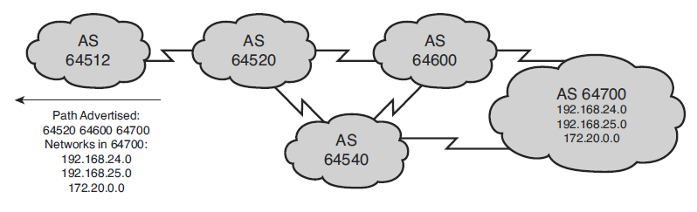
BGP Path Vector Characteristics
The path vector information includes:
A list of the full path of BGP AS numbers (hop by hop) necessary to reach a destination network.
Other attributes including the IP address to get to the next AS (the next-hop attribute) and how the networks at the end of the path were introduced into BGP (the origin code attribute).

Slide 39
When to Use BGP
Most appropriate when the effects of BGP are well-understood and at least one of the following conditions exists:
The AS has multiple connections to other autonomous systems.
The AS allows packets to transit through it to reach other autonomous systems (eg, it is a service provider).
Routing policy and route selection for traffic entering and leaving the AS must be manipulated.

Slide 40
When Not to Use BGP
Do not use BGP if one or more of the following conditions exist:
A single connection to the Internet or another AS.
Lack of memory or processor power on edge routers to handle constant BGP updates.
You have a limited understanding of route filtering and the BGP path-selection process.
In these cases, use static or default routes instead.

Slide 41
Enable BGP Routing
Define BGP as the IP routing protocol.
Router(config)#
router bgp autonomous-system
The autonomous-system value is either an internally generated number (if not connecting to a provider network) or obtained from an ISP or RIR.
It is a required parameter.
It can be any positive integer in the range from 1 to 65535.
Only one instance of BGP can be configured on the router at a single time.
Notes:
The autonomous system number in this command is compared to the autonomous system numbers listed in neighbor statements to determine if the neighbor is an internal or external neighbor.
The syntax of basic BGP configuration commands is similar to the syntax for configuring internal routing protocols. However, there are significant differences in how BGP functions.
Use the router bgp autonomous-system command to identify to the router that any subsequent subcommands belong to this routing process. This command also identifies the local autonomous system in which this router belongs. The router needs to be informed of the autonomous system so it can determine if the BGP neighbors to be configured next are either Internal Border Gateway Protocol (IBGP) or External Border Gateway Protocol (EBGP) neighbors. The following table describes the router bgp command parameter:
The router bgp Command Parameter
The autonomous-system parameter identifies the local autonomous system number. The route bgp command alone cannot activate BGP on a router. You must enter at least one subcommand under the router bgp command to activate the BGP process on the router.
If you place your router in autonomous system “A” and then try to configure a new router bgp “B” command, the router informs you that you are currently configured for autonomous system A. You must insert the autonomous system number in the router bgp command so that the router can properly identify the relationship between the neighboring router and itself.

Slide 42
BGP Router-ID
Router ID is a tie-breaker for BGP path selection if all other metrics (accessibility, administrative weight, local preference, etc.) are equal.
Use the address configured by the bgp router-id command
Use the Loopback interface address with the highest IP address
Use the highest IP address of an operational interface

Slide 43
Defining BGP Neighbors
Identify peer router with which to establish a BGP session.
Router(config-router)#
neighbor {ip-address | peer-group-name} remote-as autonomous-system
The ip-address is the destination address of the BGP peer.
The address must be reachable.
The autonomous-system value is used to identify if the session is with internal BGP (IBGP) peers or with external BGP (EBGP) peers.
If the value is the same as the router’s AS, then an IBGP session is attempted.
If the value is not the same as the router’s AS, then an EBGP session is attempted.
Notes:
You use the neighbor ip-address remote-as autonomous-system command to activate a BGP session for external and internal neighboring routers.
This command identifies a peer router with which the local router will establish a session. The following table describes the neighbor remote-as command parameters:
Parameter Descriptions
ip-address Identifies the peer router.
peer-group-name Identifies the name of a BGP peer group.
autonomous-system Identifies the autonomous system of the peer router. A peer group is a group of BGP neighbors of the router being configured that all have the same update policies. Peer groups are described later in this lesson.
This command is mandatory for the establishment of each neighboring router relationship.
The address that is used in this command is the destination address for all BGP packets going to this neighboring router. In order for BGP to pass BGP routing information, this address must be reachable, because BGP attempts to establish a TCP session and exchange BGP updates with the device at this IP address.
The autonomous system number that is a part of this command is used to identify if this neighbor is an EBGP neighbor or an IBGP neighbor. If the autonomous system number is the same as the autonomous system number for this router, that neighbor is an IBGP neighbor and the IP address listed in this neighbor command does not have to be directly connected. If the autonomous system number is different from the autonomous system number for this router, this neighbor is an EBGP neighbor and the address in this neighbor command must be directly connected by default.

Slide 44
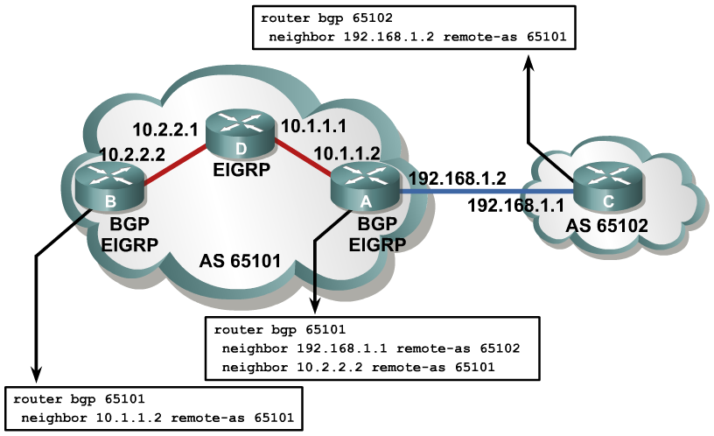
Example: BGP neighbor Command
Notes:
Example: BGP neighbor Command
In this figure, router A in AS 65101 has two neighbor statements. Router A knows that router C (neighbor 192.168.1.1 remote-as 65102) is an external neighbor because AS 65102 in the neighbor statement for router C does not match the autonomous system number of router A, which is AS 65101. Router A can reach AS 65102 via 192.168.1.1, which is directly connected to router A.
Neighbor 10.2.2.2 (router B) is in the same autonomous system as router A; the second neighbor statement on router A defines router B as an IBGP neighbor.
AS 65101 runs Enhanced Interior Gateway Routing Protocol (EIGRP) between all internal routers. Router A has an EIGRP path to reach IP address 10.2.2.2. As an IBGP neighbor, router B can be multiple routers away from router A.

Slide 45
Originating a route – Network command
The command does not start BGP on specific interfaces
Will inject into BGP any prefix that has an exact match in the route table
router bgp 100
network 200.22.0.0 mask 255.255.0.0

